Slide 1
PROJECT FOR ADVANCED SYSTEMS PROGRAMMING
MOVIE BANK:
AN APPLICATION TO HELP YOU FIND NUMOUS MOVIES WORLDWIDE
Group 6, The University of Windsor
Yinlin Liao 104380332
Jimei Peng 104494147
Juzhou Zhang 104557945
Hang Zhou 104357381
Yuze Zou 104526851

Slide 2
Contents
01
INTRODUCTION
Background, Goals and Risks
02
DESIGN OVERVIEW
The Structure of The server and Clients
03
TOOLS & LANGUAGES
A List of Tools and Languages Used
04
APPLICATION DEMO
How The Sever Works And Scripts
05
SUMMARY
Links and Resources

Slide 3
INTRODUCTION
Movie as one of good art performance methods can record different lifestyles in different countries, diverse periods’ cultures, various concepts of value even the modes of thinking. Since movies can spread to all around the world, audiences will gain many inspirations, knowledge, and broad horizons. Thus movie has become a tendency in people’s lives. At the same time, numerous companies have seen this trend so that they create plenty of movie application to fulfill people’s needs such as searching movies based on performers, directors, styles, years, and so on.
For example, IMDb is the biggest online movies search engine. Users can operate customize searching method to find the movies that they prefer.
Our team obtained some inspirations from IMDb.
Background
information

Slide 4
The goal of our project is to implement client-sides which can input the information from users and get output results from server, and server-side which can handle the keywords from user, search related information from movie DB, and give the correct information to client-sides. Tons of movies can be found here.
The business risk are the main risks of our project. The reason is our group do not make enough market investigation that do people want to use the project that we make. Furthermore, we do not sure that our project can copy with all needs of users. Therefore, our group should have some other feedback researches which not only can improve the functions of our project, but also it can help us to accurately know the business marketing trends.
Goals &
risks

Slide 5




DESIGN OVERVIEW
client A: shell
JSON format message
server
database
JSON format message
MySQL sever
client B: Android

Slide 6
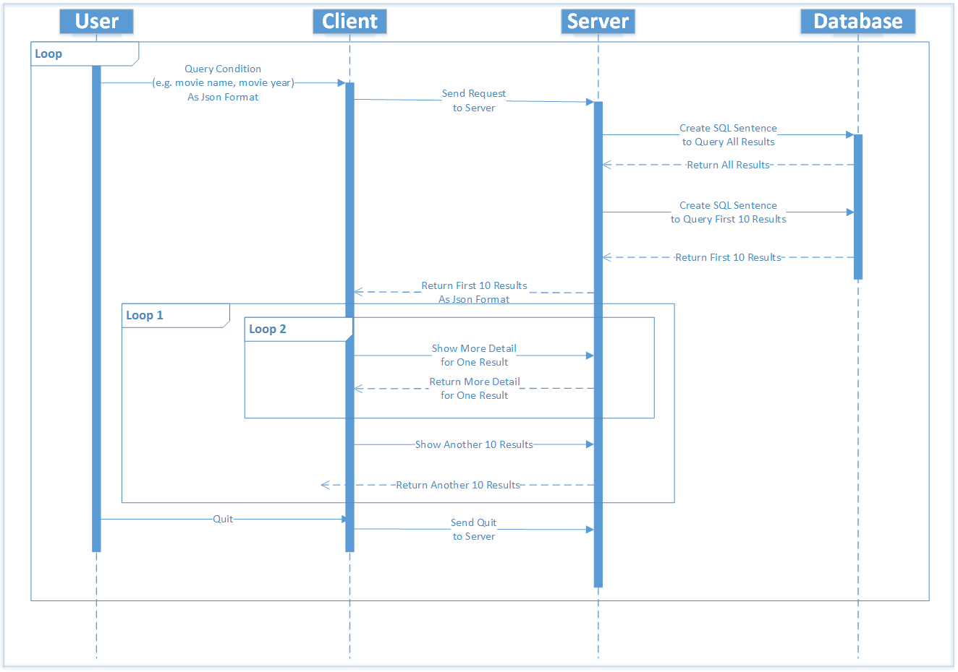

Slide 7







TOOLS & LANGUAGE
C Language:
Establish the server.
Establish the database.
Project record management.
Project version control.
C utility on shell:
Connect with server.
Build the Android client.
Socket:
Communicate between server and shell clients.
Json:
Message format used in communication between server and clients.
The platform of server and client A.
Android
The platform of client B.

Slide 8
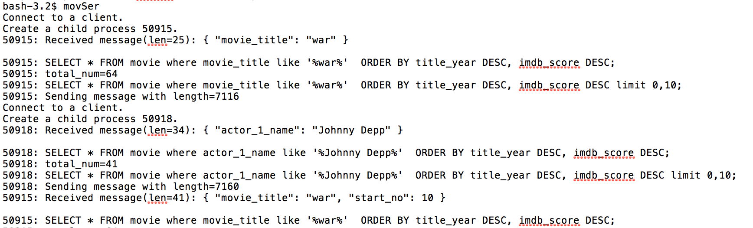
server
client 1 (shell)
client 2 (Android)
APPLICATION DEMO
Connect to a client and fork a child process.
Child process receive message from a client.
Child process send message to a client.
Connect to anther client and fork another child process.

Slide 9
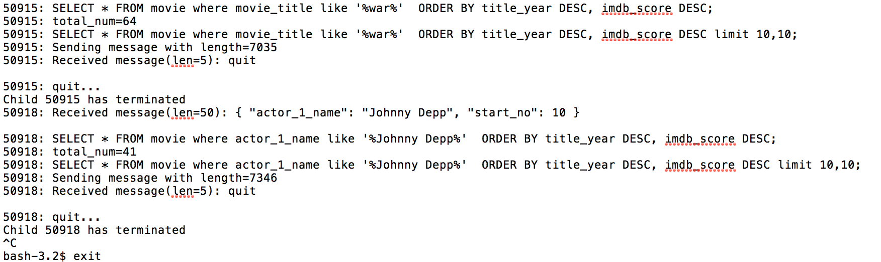
server
client 1 (shell)
client 2 (Android)
One child process receive the quit message and terminate.
Another child process receive the quit message and terminate.

Slide 10
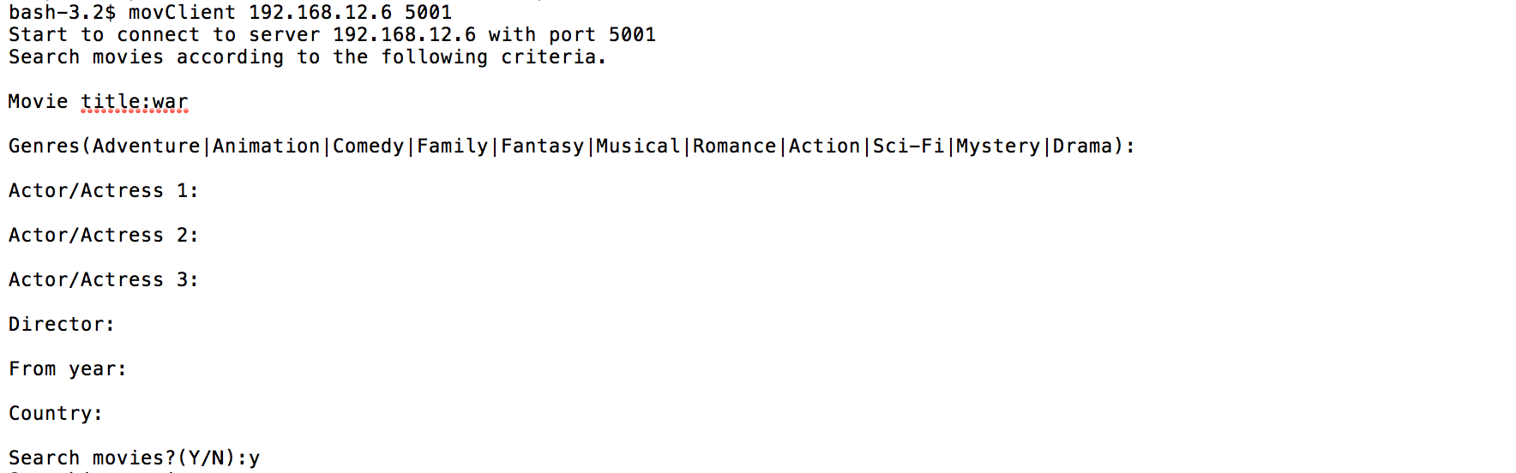
server
client 1 (shell)
client 2 (Android)
Use different key words to search
Input Y to start searching

Slide 11
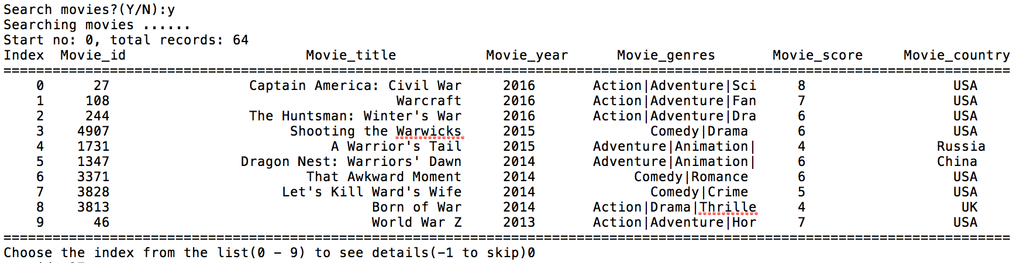
server
client 1 (shell)
client 2 (Android)
The index number is request by user to start the search.
How many matched movies
Basic information of one movie
Show the first 10 movies
Use the index to choose the movie that want more information

Slide 12
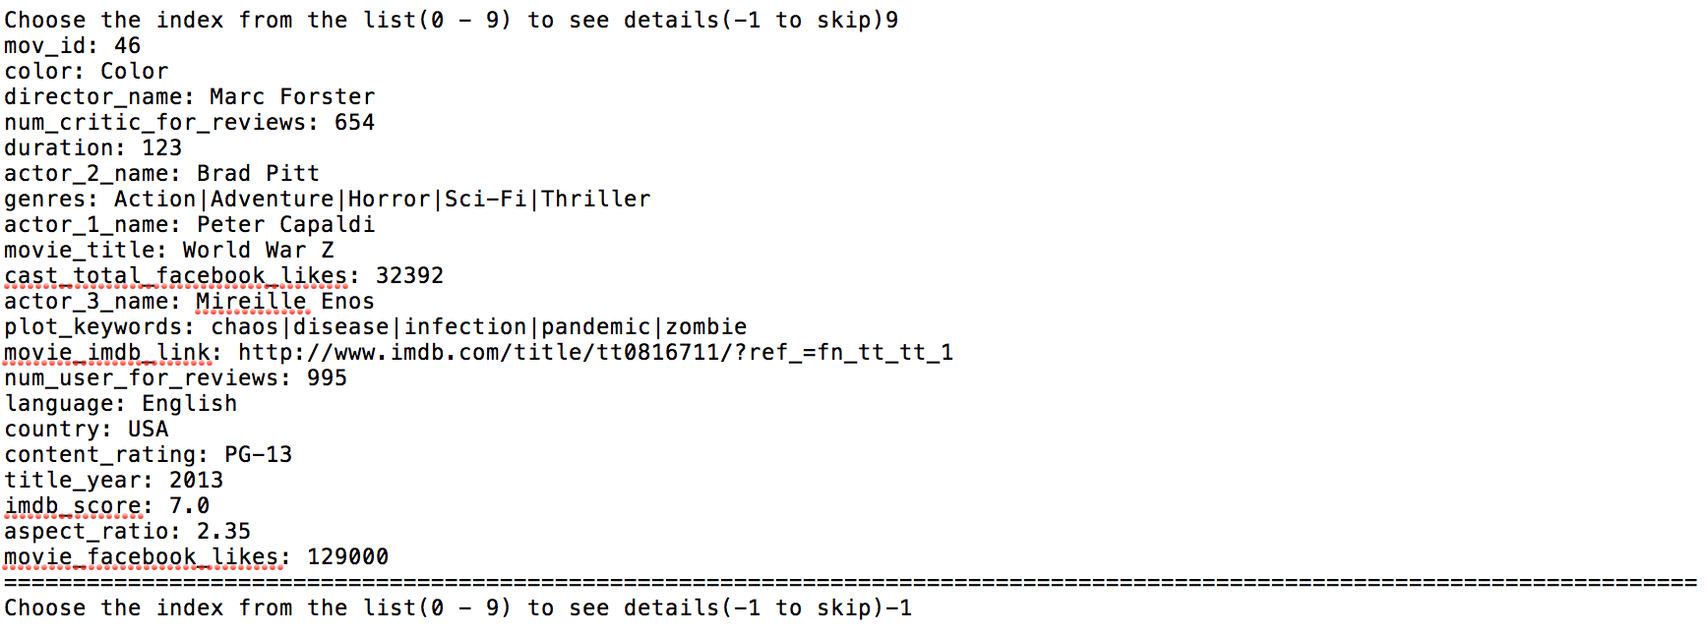
server
client 1 (shell)
client 2 (Android)
All information of chosen movie
Use the index to choose a movie again or input -1 to skip

Slide 13
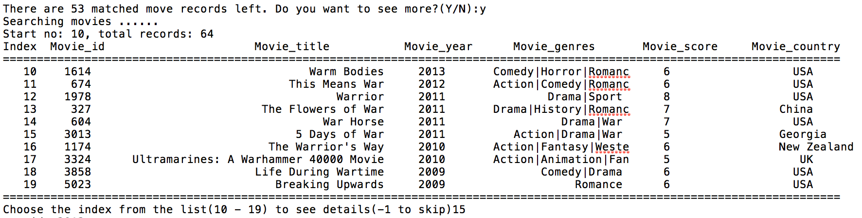
server
client 1 (shell)
client 2 (Android)
Shows that how many matched movies left and use Y to see more movies
Show next 10 movies
Use the index to choose a movie again or input -1 to skip

Slide 14
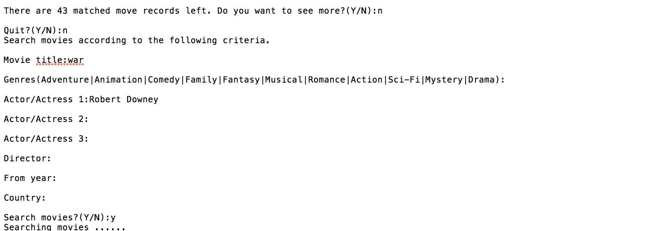
server
client 1 (shell)
client 2 (Android)
Shows that how many matched movies left and use N to search different movies
Use N to search more movies
Or Y to end the searching

Slide 15
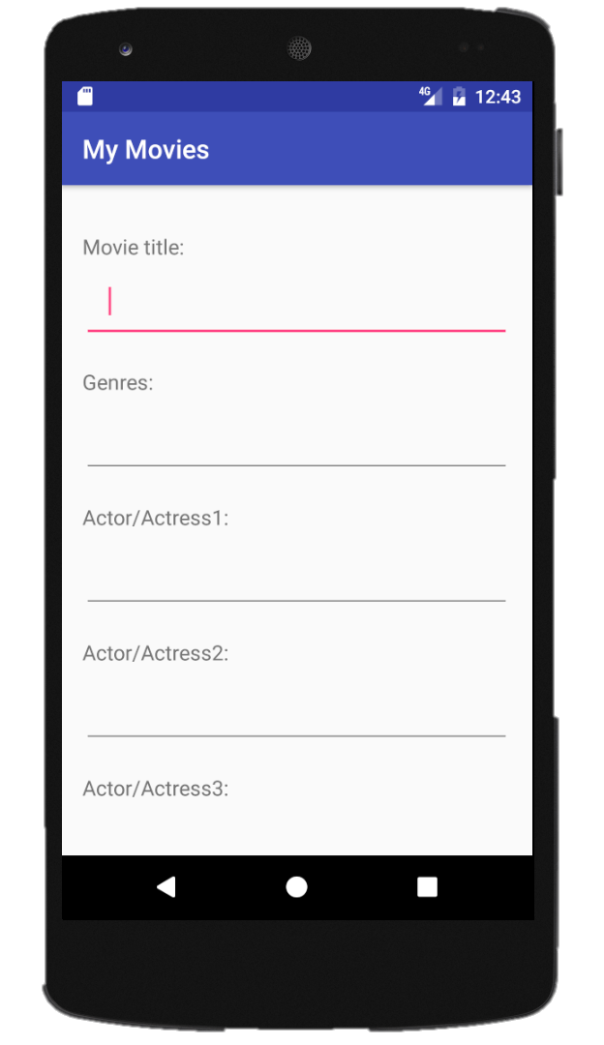
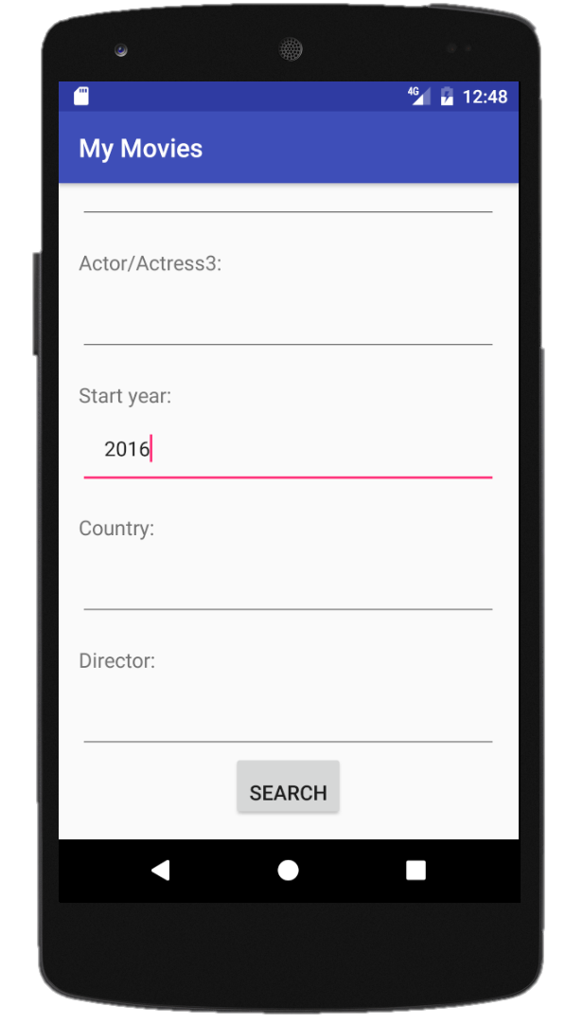
server
client 1 (shell)
client 2 (Android)
Filter Page:
Input keyword for
searching
Input field
Press button to
search

Slide 16
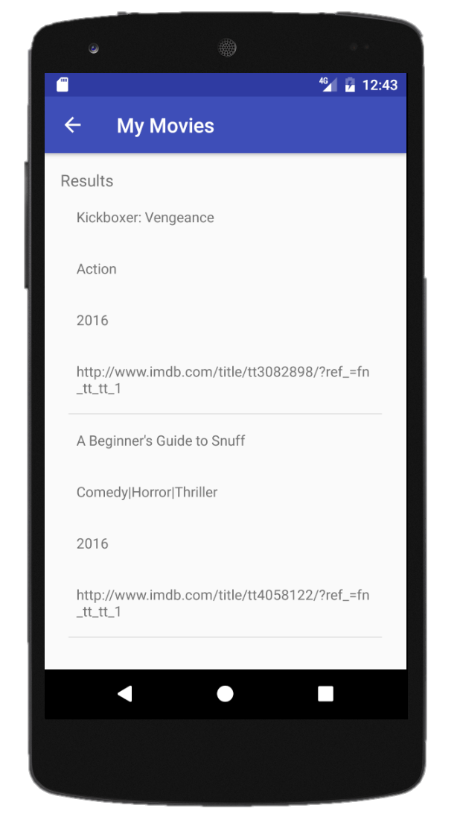
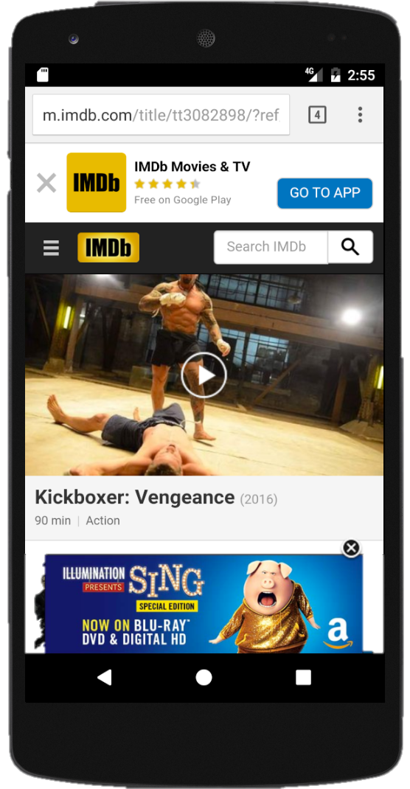
server
client 1 (shell)
client 2 (Android)
Result Page:
Movie name
Genres
Year
Click the link to get details
Scroll to load more

Slide 17
SUMMARY
Links
Redmine:
https://redmine.cs.uwindsor.ca/projects/group_6
Github:
https://github.com/jmpeng/movie_bank
Resources
https://www.kaggle.com/datasets
https://www.google.ca/imghp?hl=en&ei=MzDPWLTWIIrbjwSZg42oCg&ved=0EKouCAIoAQ

Slide 18
THANK YOU
MARCH 24 2017

